Slide 1

Let’s start with Allah Yaar
Bs in Computer Science

Slide 2
Introduction to Microsoft Office
Microsoft Office is a suite of productivity applications designed to make various professional tasks more manageable.
Common Applications of MS Office
Microsoft Word (For creating, editing, an documents)
Microsoft Excel (A spreadsheet program for data d formatting analysis, calculations, and charting)
Microsoft PowerPoint (A presentation software used to create slide-based presentations.)

Slide 3
Introduction to Microsoft Office
Microsoft Outlook (An email client with calendar, task management, and scheduling functions.)
Microsoft Access (A database management system for organizing large amounts of data.)
Microsoft OneNote (A note-taking program for organizing and storing notes.)

Slide 4
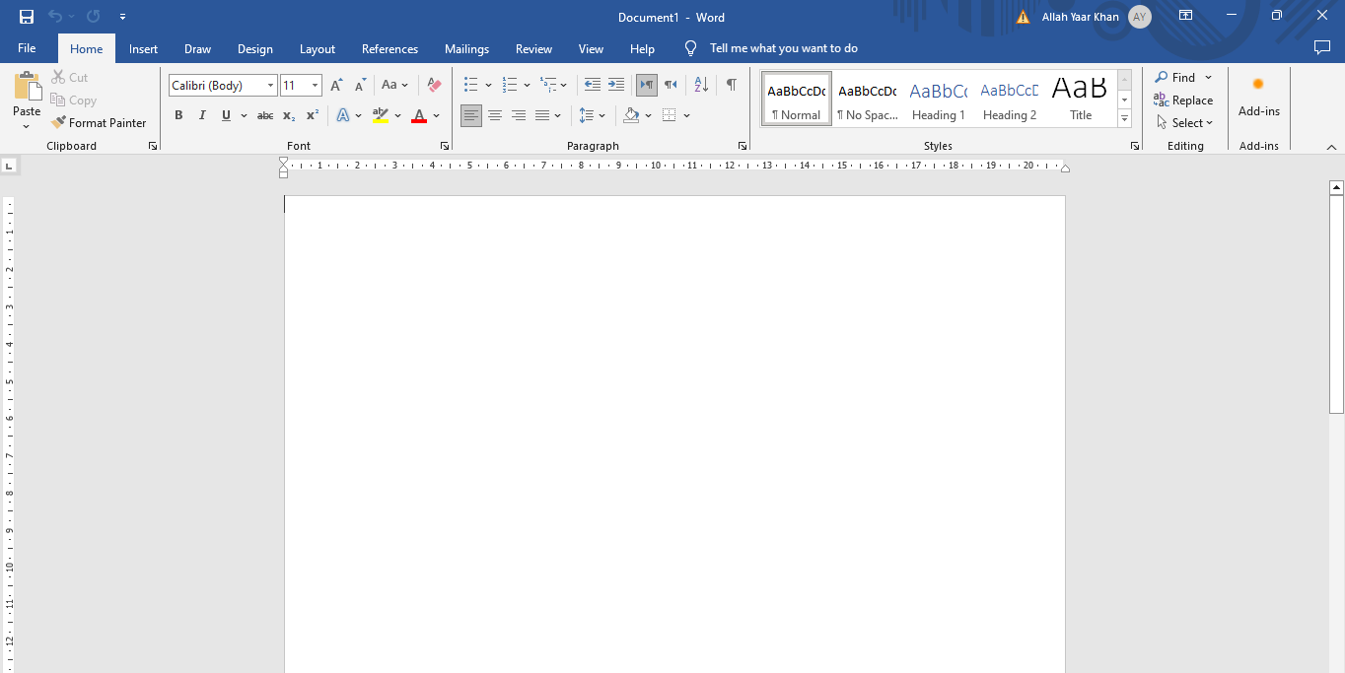
Introduction to MS Word
MS Word allows users to create, edit, and format documents easily, making it essential for tasks like writing letters, creating reports, and designing professional documents.

Slide 5
Major Parts of MS Word
Title Bar: Displays the name of the document and program.
Ribbon: Contains tabs such as Home, Insert, Design, etc., with tools and options for formatting and editing.
File Tab: Provides access to document-related actions like saving, opening, and printing.
Quick Access Toolbar: A customizable toolbar for frequently used commands.
Document Area: The main area where text and content are added.

Slide 6
Major Parts of MS Word
Status Bar: Displays information about the document, like word count and page number.
Scroll Bars: Allow navigation through the document.

Slide 7
Shortcut Keys of MS Word
Ctrl + N: New document
Ctrl + O: Open a document
Ctrl + S: Save a document
Ctrl + P: Print a document
Ctrl + C: Copy selected text
Ctrl + X: Cut selected text
Ctrl + V: Paste
Ctrl + Z: Undo

Slide 8
Shortcut Keys of MS Word
Ctrl + Y: Redo
Ctrl + B: Bold text
Ctrl + I: Italicize text
Ctrl + U: Underline text
Ctrl + A: Select all text
Ctrl + F: Find text
Ctrl + H: Replace text
Ctrl + Home: Go to the beginning of the document
Ctrl + End: Go to the end of the document

